Slide 1
Programming 1 - WEEK 4
Loops

Slide 2
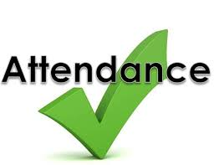

Slide 3

Recap
Arithmetic
Booleans
Conditionals
None
Strings

Slide 4

Permanent Evaluation
Time limit
6 questions – 6 minutes
Everyone gets 30% extra
Rounded to 10 minutes maximum
Scrap paper
Only colored scrap paper handed by the lecturer
Put it RIGHT in front of you, RIGHT in front of your laptop
Hand in after the test

Slide 5
Permanent Evaluation
Be quiet - no talking
Don't cheat
Look at your own screen
ONLY allowed to be on ANS
No GenAI – No VSCode – ...
No ppt – No notes – ...
Browser full screen
Display Light 100%
Guess correction: - 1 / (# options – 1)
Close your laptop when finished

Slide 6


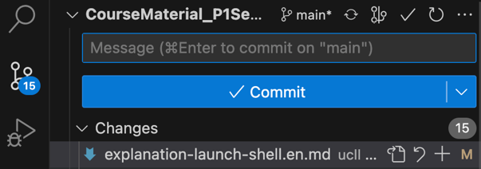
Git: pulling changes
If you get an error telling you that you have to set a default merge strategy:
(then pull again)
If you get an error telling you that you have conflicting working changes, make sure to discard any changes you might have made to assignment or test files. (Changes to student.py files are ok since we don't modify those)

Slide 7
Programming 1 - WEEK 4
Loops

Slide 8
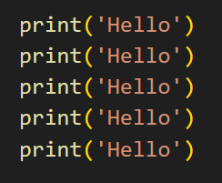

For loop

Slide 9
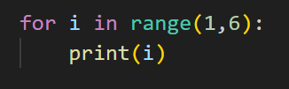
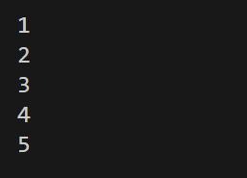
For loop

Slide 10
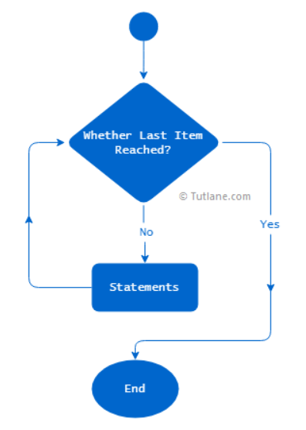

For-loop
i loop-variable
start start-value for i (included)
stop stop-value for i (excluded)

Slide 11






Range
→ start is assumed to be 0

Slide 12

Exercise - Count spaces
Write a function count_spaces(text) that returns the number of spaces in the input parameter text.

Slide 13
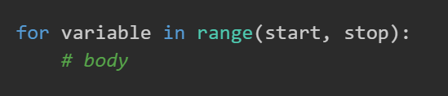
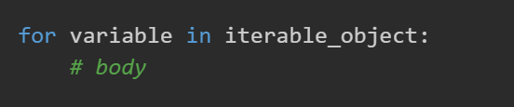

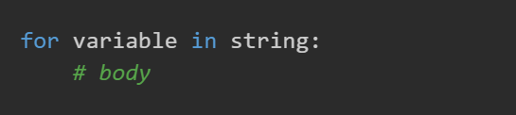
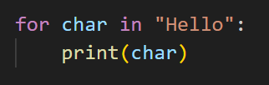
String iteration

Slide 14
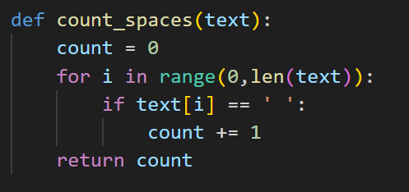
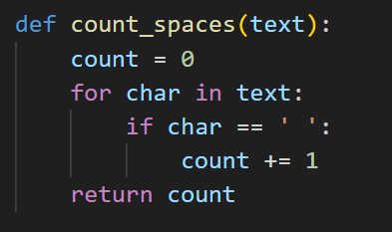
Exercise - Count spaces
Write a function count_spaces(text) that returns the number of spaces in the input parameter text.

Slide 15
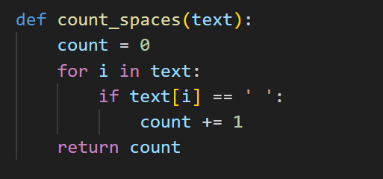

Exercise - Count spaces
Write a function count_spaces(text) that returns the number of spaces in the input parameter text.

Slide 16
Exercise - Guess number
Write a function guess_number(number) where a user must guess the parameter number. The function should ask the user to guess a number in the terminal, it should print whether the guess was correct, too low, or too high. If the guess is not correct, the user should be allowed to guess again until the correct number is guessed.

Slide 17
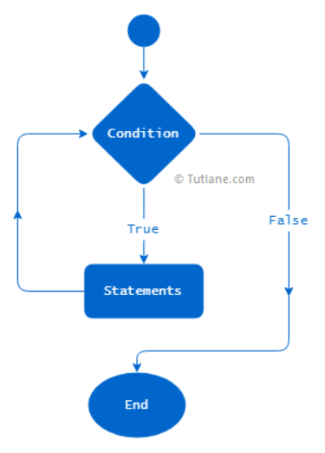

While-loop
Condition needs to change inside the while loop!

Slide 18
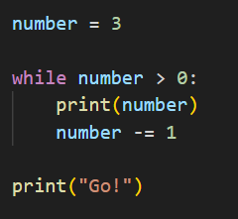
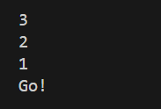
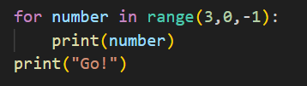
While loop

Slide 19
Exercise - Guess number
Write a function guess_number(number) where a user must guess the parameter number. The function should ask the user to guess a number in the terminal, it should print whether the guess was correct, too low, or too high. If the guess is not correct, the user should be allowed to guess again until the correct number is guessed.

Slide 20
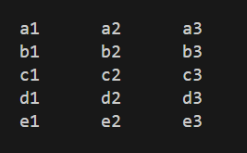
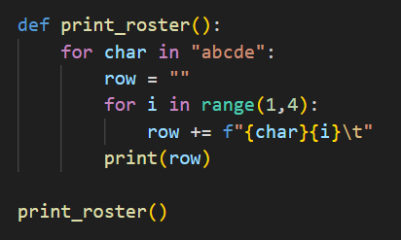
Extra - Nesting
Terminal
5 rows: a – b – c – d – e – f
3 columns: 1 – 2 – 3

Slide 21
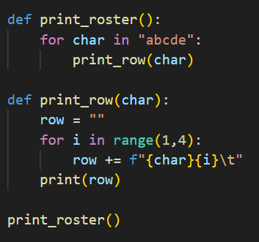
Extra - Nesting
This is possible, but it might be better to create seperate functions

Slide 22

Questions?

Slide 23
Exercises
Write a function count_spaces(text) that returns the number of spaces in the input parameter text.
Write a function guess_number(number) where a user must guess the parameter number. The function should ask the user to guess a number in the terminal, it should print whether the guess was correct, too low, or too high. If the guess is not correct, the user should be allowed to guess again until the correct number is guessed.

